Slide 1



Integrated Climate Change Adaptation (CCA) and Flood Risk management Strategy and Plan for the Drin River Basin
Draft
Transboundary FRM Action Plan Drin River Basin 2025 - 2035
Sept. 2024

Slide 2
Table of Contents
Overview of FRM in the Riparian Countries
Selection of the Areas of Mutual Concern
Harmonized Catalogue of FRM Measures
Scoring, Prioritization, & Ranking of FRM Measures by Macro-areas
Transboundary High-Priority FRM Measures
Structure of the Transboundary FRM Action Plans
Consultation Process, Stakeholder Engagement for Validation FRM Strategy & FRM Action Plan

Slide 3
Status of FRM in Riparian Countries
Drin/Drim – Buna/Bojana River Basin – EU Floods Directive
PFRA – Preliminary FR Assessment
(Art. 4+5)
1
KOSOVO
Flood Hazard Maps for APSFRs
(Art. 6(1))
NORTH MACEDONIA
MONTENEGRO
2
ALBANIA
Flood Risk Maps/ Vulnerability, Damage Assess. (Art. 6 (5))
Flood Risk Management Plans
(Art. 7)
Single FRMP for Transboundary River Basin (Art. 8)*
3

Slide 4
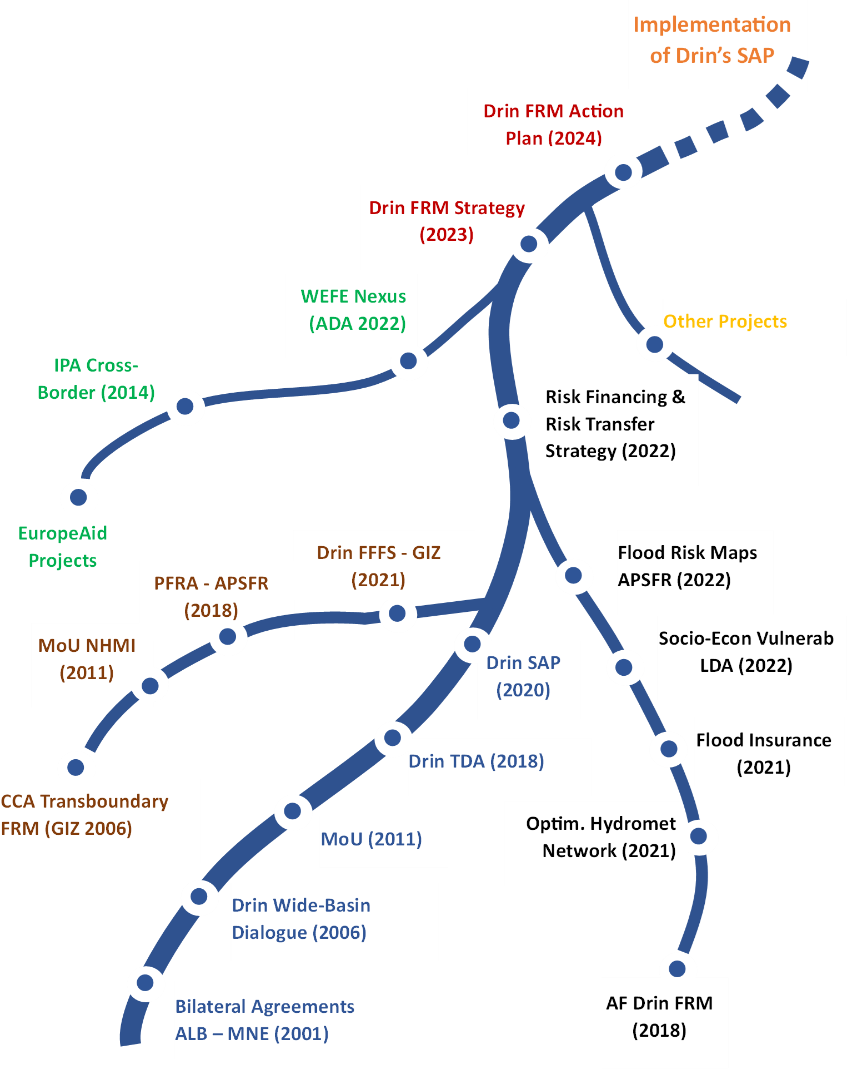
Main Projects in the FRM Sector
We are Here
Cornerstone Projects of the Transboundary Drin FRM Dialogue
AF Drin FRM Project (GWP – Med, UNDP, (2018 - 2024)
EU IPA - Instrument for Pre-accession Assistance to EU candidates (AL, MNE, Disaster Risk Assessment & Mapping)
GEF Drin Project (GWP – Med, UNDP, UNECE (2011 - 2018)
GIZ - Climate Change Adaptation through Transboundary Flood Risk Management in the Western Balkans (2006 – 2021)

Slide 5
Transboundary Areas of Mutual Concern
(Priority 1 – APSFR)

Slide 6
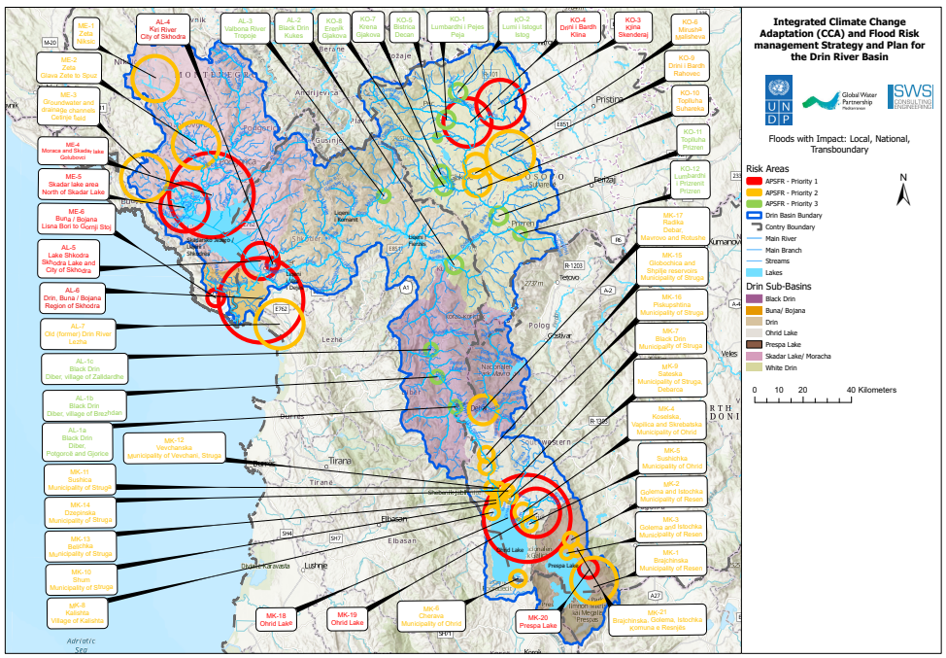
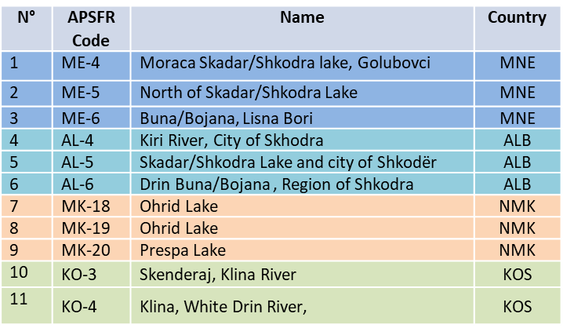
Selection of the AMC - Areas of Mutual Concern
Based on the GIZ’s PFRA (The only FRM study at the Transboundary level)
The FRM Action Plan will focus only on the selected AMC (11)
Multi-Criteria Analysis for Selection of the AMC

Slide 7
Transboundary FRM Action Plan
Preliminary Analysis
What Extension for FRM Action Plans (sub-basin level / admin border, what analysis unit) ?
Number of FRM Action Plans (One by single AMC – APSFRs, only one) ?
What Spatial Scale (local scale, national scale, transboundary scale) ?
Selected Criteria: Homogeneous Flooding Macro-Areas
(Guidance for Reporting of the EU FD, Classification of Floods according to own characteristics)
Mechanism of Flooding (how and why floods happen)
Type / Characteristics of Flooding (hydrological regime, spatial & temporal dynamics)
Source of Flooding (main origin of the flood water volumes)

Slide 8
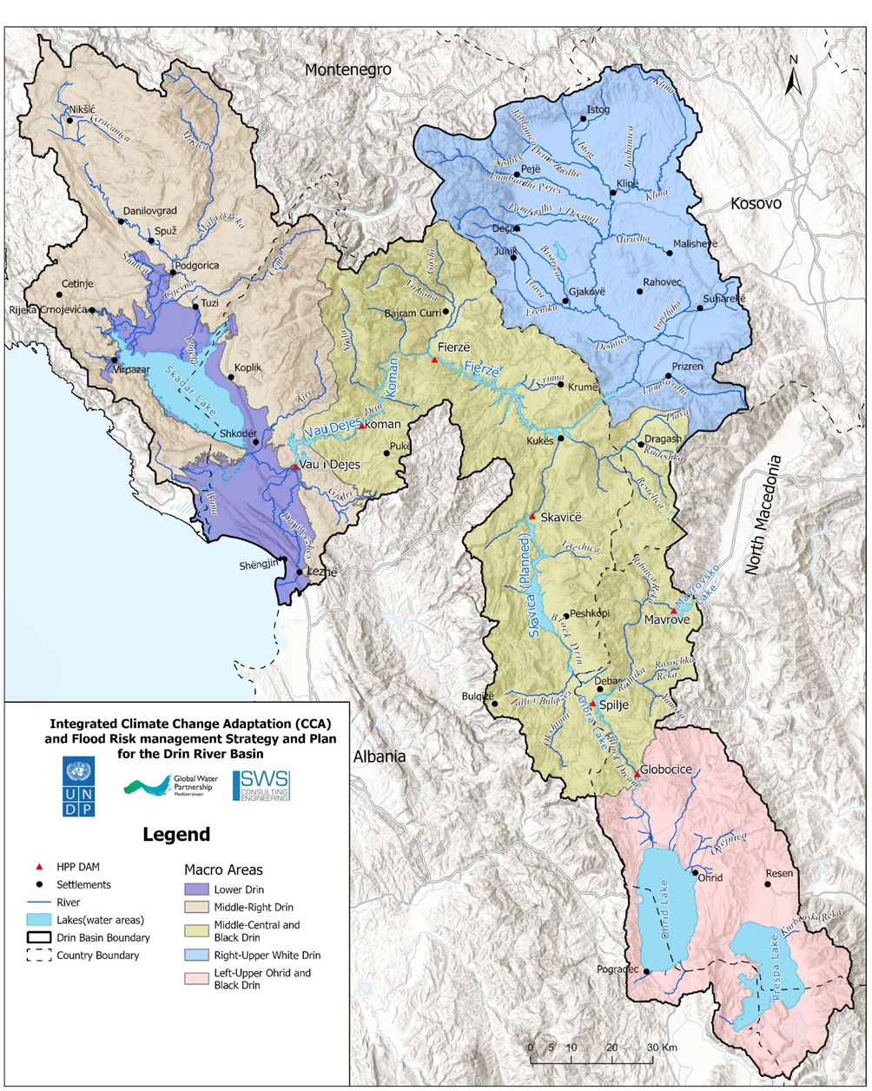
Homogenous Flooding Macro-areas
Advantages of the HFM
Harmonization: most FRM measures can be considered common or similar (same Category)
Coordination: Common implementation of FRM measures by the riparian countries
Prioritization: Facilitate flood governance and identification of the High Priority FRM interventions
Floods Control Factors: Natural & anthropic factors that regulate the dynamics of the floods, and must be carefully considered

Slide 9
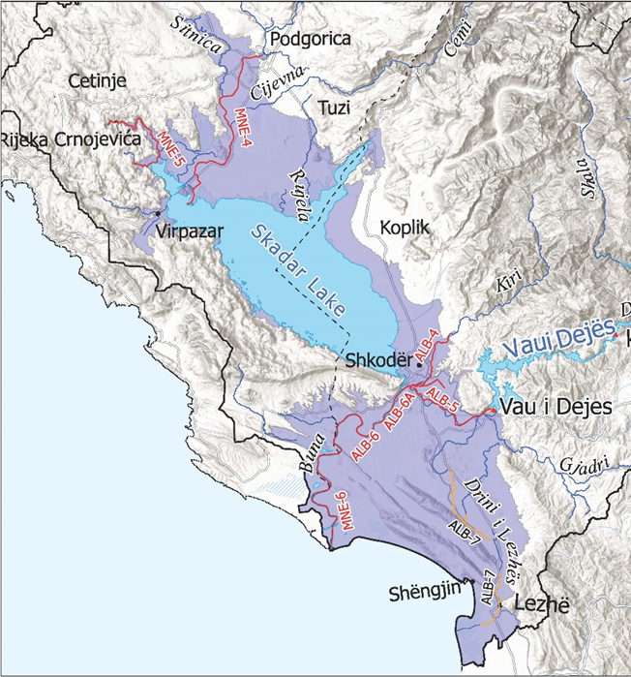
Lower Drin Macro-area
Flooding Regime
Key elements of the AMC (Priority 1 – APSFR)

Slide 10
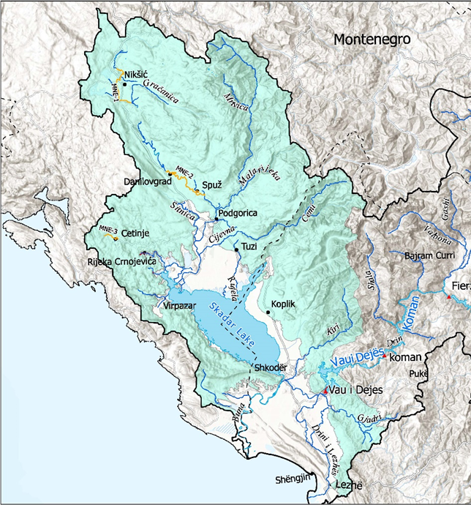
Medium/Upper Skadar Macro-area
Does not include any AMC
No Priority 1 – APSFRs
Key elements:
Karstic environment, Local Floods
Very high Precipit regime (> 4.000 mm)*
Hydrological upper basin for the Northern Skadar Lake floods (ME-4, ME-5)
Flood peaks can overlap the peaks coming from Upper Drim (Drin Cascade Macro-area)

Slide 11
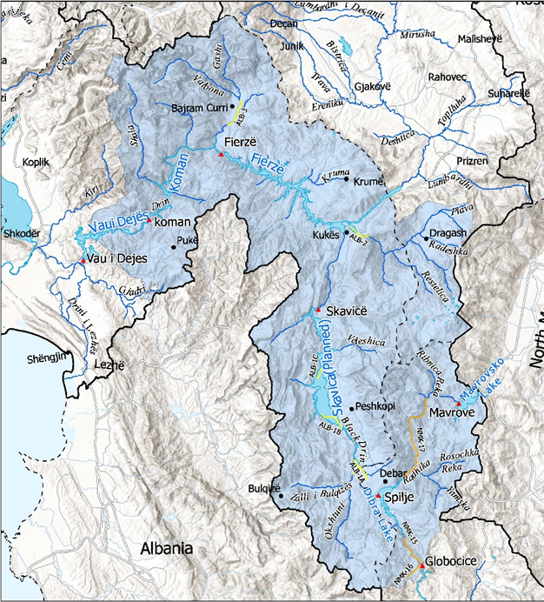
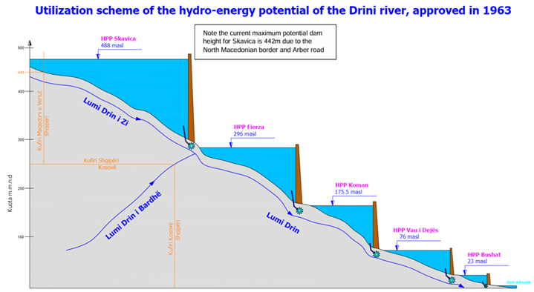
Drin Cascade Macro-area
Does not include any AMC
No Priority 1 – APSFRs
Importance:
Host the major hydro-power plans / reservoirs of the basin
Drin Cascade: Vau i Dejes, Komani, Fierze, Globocica, Debar, Mavrovo, Skavica* (feasibility phase)
Highly strategic area for flood risk management and governance

Slide 12
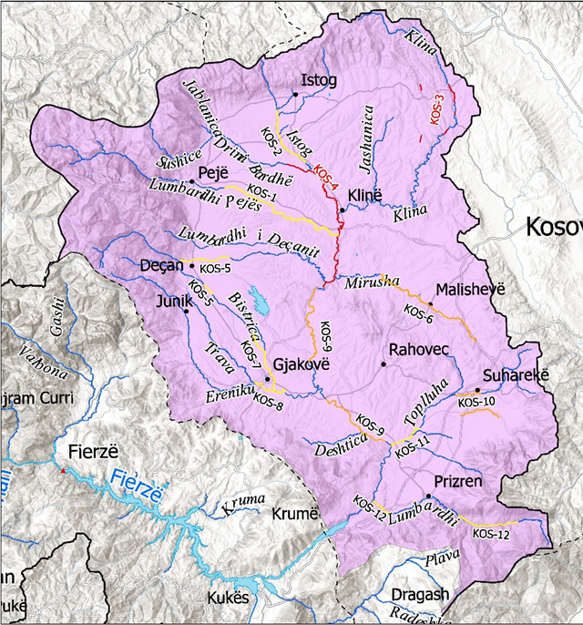
White Drin Macro-area
Flooding Regime
Key elements of the AMC (Priority 1 – APSFR)
Key elements:
Local scale Floods
Drin’s Upper Basin, critical on regulation of down-stream flows
Highly suitable for Nature-Based Solutions
Critical role on water storage (Snow), monitor SWE and early snow melting

Slide 13
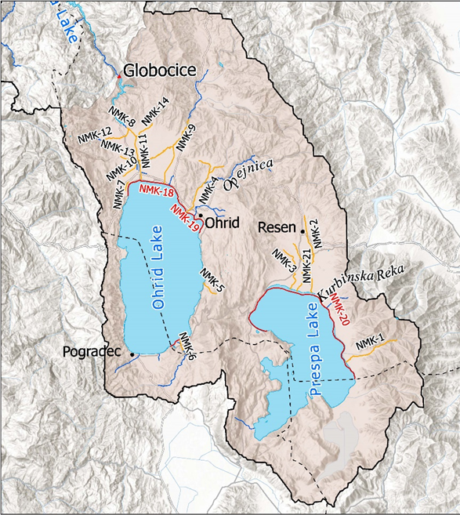
Upper Lakes Macro-area
Flooding Regime
Key elements of the AMC (Priority 1 – APSFR)
Key elements:
Local scale Floods
Drin’s Upper Basin, flood peaks are regulated by the lakes (storage, delay, peak lamination)
Highly suitable for Nature-Based Solutions
Critical role on water storage (Snow), monitor SWE and early snow melting

Slide 14
Harmonized Catalogue of Transboundary FRM Measures

Slide 15
Harmonized Catalog of FRM Measures for the Transboundary Drin River Basin
In the last 20 years, several projects in the Flood Risk sector have been carried out, most based in the EU FR Directive, unfortunately, the classification of the FRM Measures was NOT Common, preventing a transboundary analysis, inter-comparison, and management.
Based in the EU Floods Directive - Guidance for Reporting (18 FRM Categories)
NO new FRM Measures were added, integration & harmonization

Slide 16
Scoring, Prioritization, and Ranking of the FRM Measures by Macro-areas

Slide 17
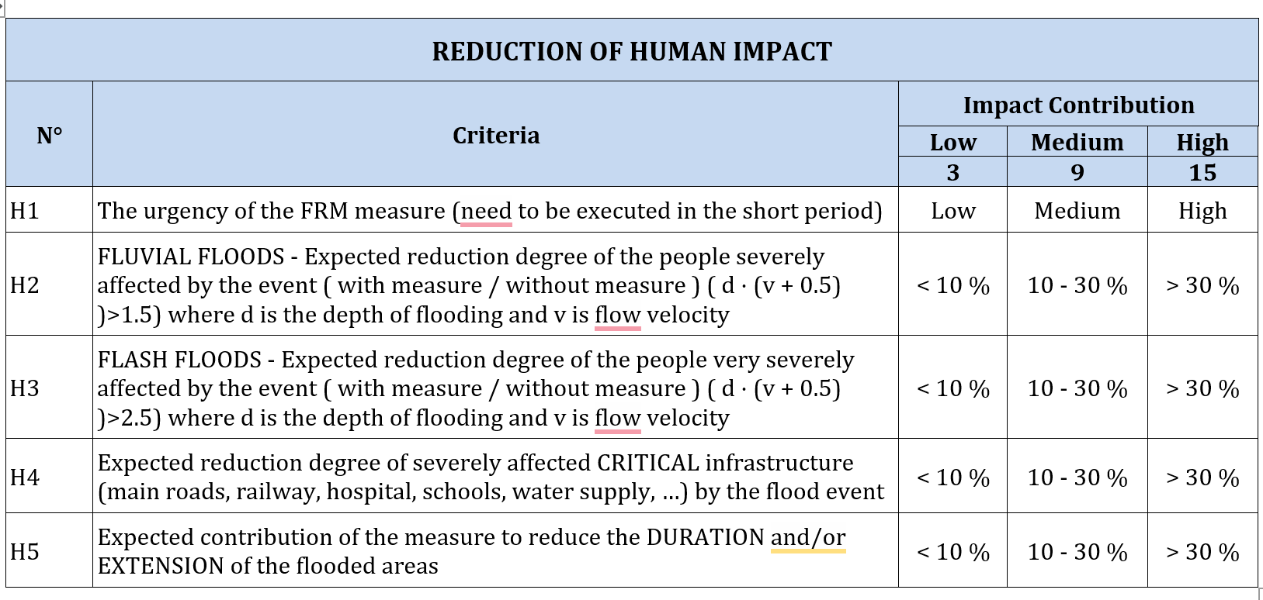
Scoring of the FRM Measures by Macro-area
Multi-Criteria Optioneering Analysis Tables
To assess the contribution of a FRM Measure (Scoring) on reducing the level of risk, Four (4) impact categories and 15 sub-criteria were used (by Macro-area)
Optioneering Analysis Table
Human Impact Category, sub-criteria (H1 – H5), classes of impact reduction (Low, Medium, High), and Scores (3, 9, 15)

Slide 18
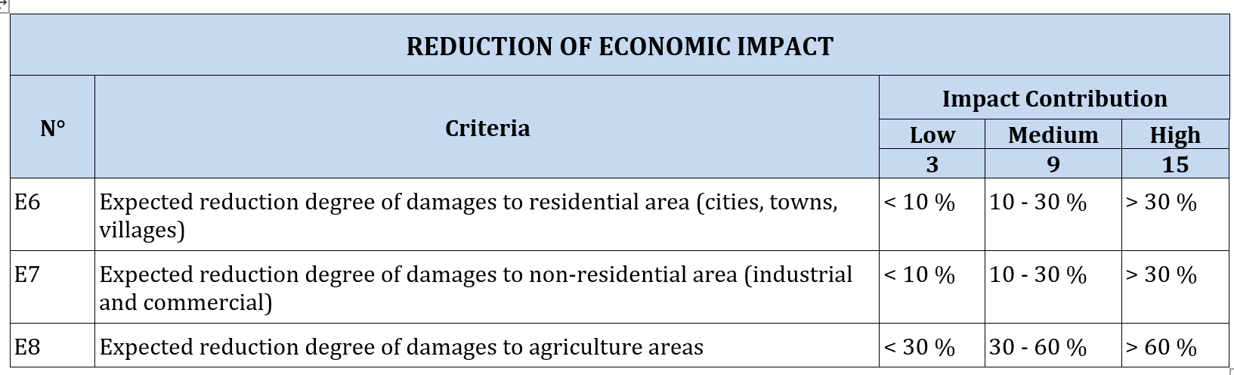
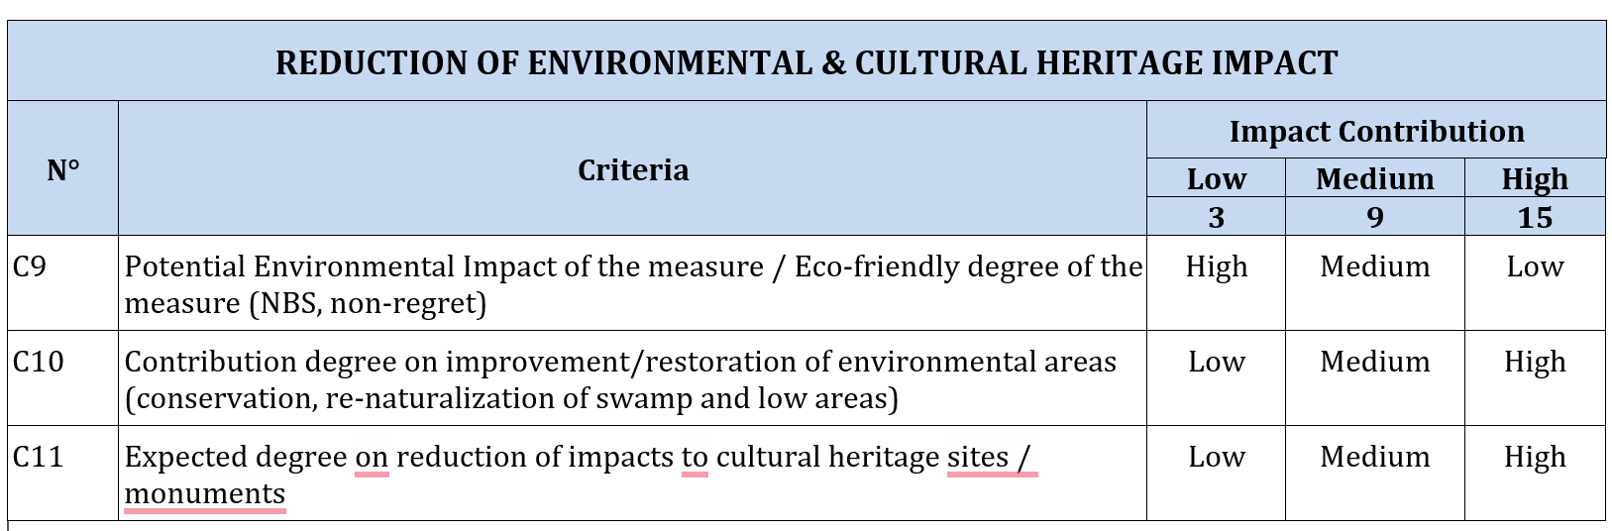
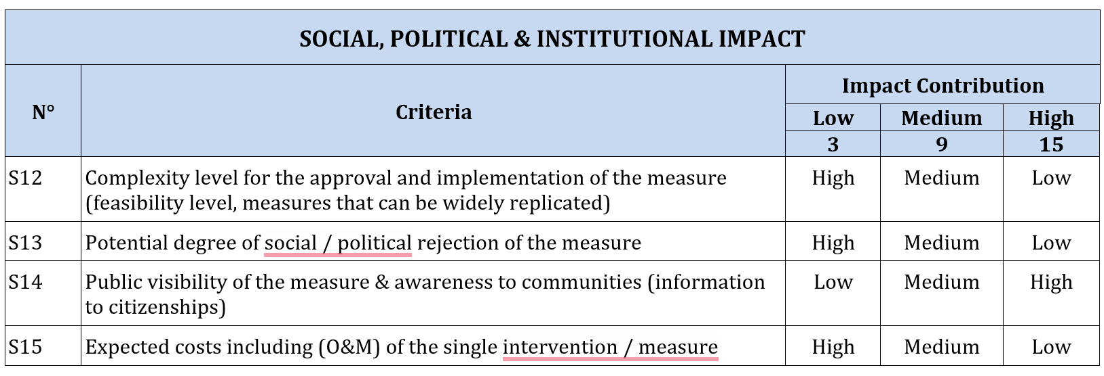
Scoring of the FRM Measures by Macro-area
Multi-Criteria Optioneering Analysis Tables
Optioneering Analysis Tables
Economic Impact, 3 sub-criteria (E6 – E8),
Environmental Impact, 3 sub-criteria (C9 – C11)
Social Impact, 4 sub-criteria (S12 – S15)

Slide 19
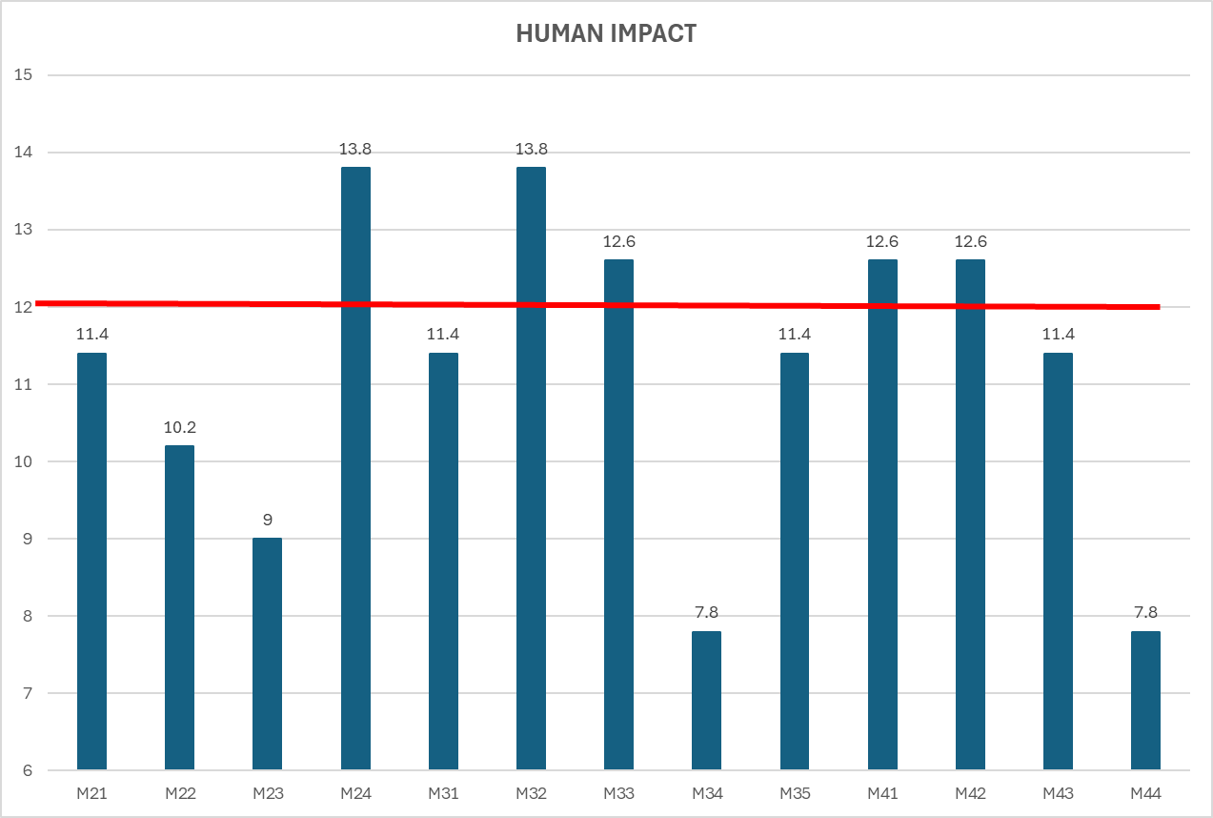
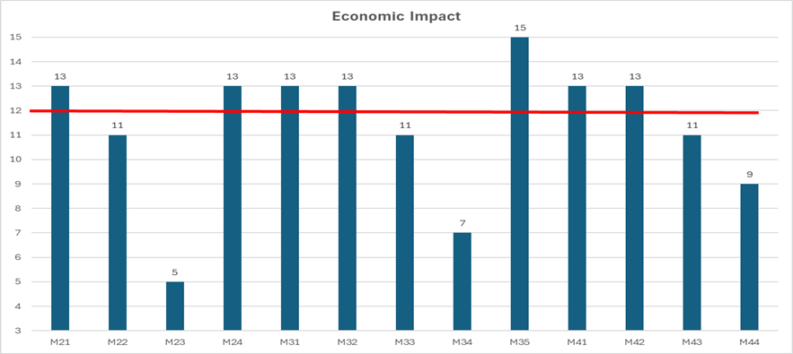
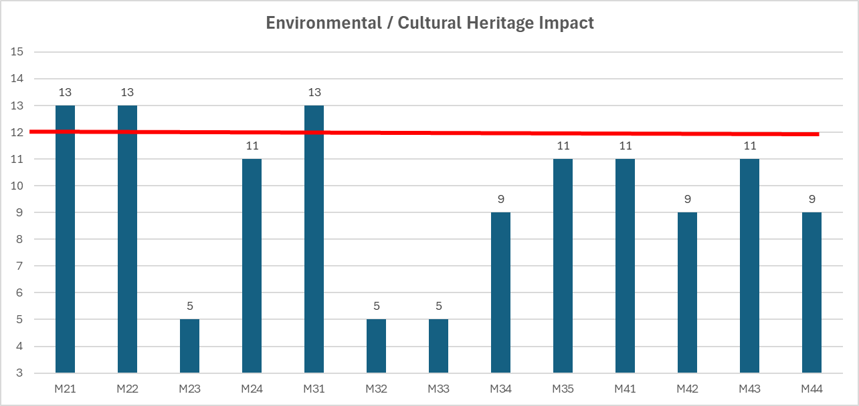
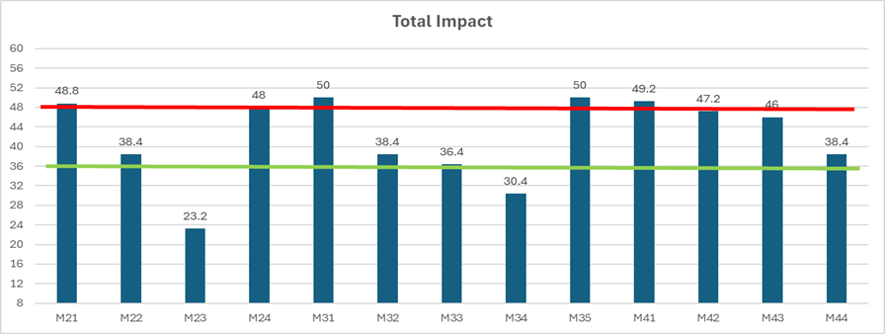
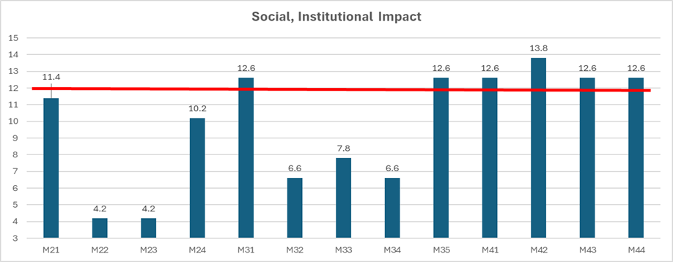
Scoring the FRM Measures by Macro-area
Example of FRM Measures Scoring (Lower Drin)
Assessing the Total Impact of the FRM Measures
The Multi-Criteria Optioneering Analysis (Scoring) was done for every category of the harmonized catalog of FRM Measures, for the four (4) impact categories and (15) criteria. Were excluded the FRM Measures of “Recovery and Review” (M51 – M53), because related to Post-disaster.
The Total Impact of the FRM Measure (contribution reducing flood risk) was calculated as the normalized average of the four (4) impact categories.

Slide 20
Prioritization of the FRM Measures by Macro-area
Total Impact (Lower Drin)
Threshold Table
Ranking and Prioritization of the FRM Categories
According to the “Total Impact” obtained (contribution degree reducing the flood risk), the FRM Measures were classified into three (3) categories, based on the above threshold table.
The FRM categories with a Total Impact greater than 48 were ranked as High priority, the categories with Total Impact in the range 36 – 48 were ranked as Medium Priority, and the Measures with Total Impact lower than 36 were ranked as Low priority. The prioritization process was done for each single macro-area. The criteria and thresholds can be optimized.

Slide 21
Ranking of the FRM Measures by Macro-area
Lower Drin
The results achieved do not pretend to be “definitive”, a first attempt that can be optimized
The scoring was done by 3 experts (2 regional + 1 international), results could vary.

Slide 22
Ranking of the FRM Measures by Macro-area
Medium / Upper Skadar
The results achieved do not pretend to be “definitive”, but a first attempt.
The scoring was done by 3 experts (2 regional + 1 international), results could vary.

Slide 23
Ranking of the FRM Measures by Macro-area
Drin Cascade
The results achieved do not pretend to be “definitive”, but a first attempt.
The scoring was done by 3 experts (2 regional + 1 international), results could vary.

Slide 24
Ranking of the FRM Measures by Macro-area
White Drin
The results achieved do not pretend to be “definitive”, but a first attempt.
The scoring was done by 3 experts (2 regional + 1 international), results could vary.

Slide 25
Ranking of the FRM Measures by Macro-area
Upper Lakes
The results achieved do not pretend to be “definitive”, but a first attempt.
The scoring was done by 3 experts (2 regional + 1 international), results could vary.

Slide 26
Transboundary High-Priority FRM Measures

Slide 27
Transboundary High-Priority FRM Measures
It Can Be Observed:
Only Six (6) FRM categories were identified as high-priority. Two (2) prevention (M21, M24), two (2) protection (M31, M35), and two (2) Preparedness (M41, M42).
The Lower Drin is the only macro-area that includes all six (6) high-priority FRM measures.
M31 – Natural Flood Management is the sole FRM Measure common for all homogeneous flooding macro-areas

Slide 28
Other Transboundary High-Priority FRM Measures
Agriculture Sector:
Improve the agricultural resilience in flood-prone areas, Development and Enforcement of Sustainable Land Use Policies (Coping with Floods)
Improvement of drainage systems
Energy (Hydropower) Sector:
Enhance Reservoir Storage Capacities and Modernize Hydropower Facilities
Promote Regional Cooperation and Integrated Water Management
Risk Financing & Risk Transfer
Promotion of Insurance products and Tax incentives (Italy, mandatory since 01/01/25)
Public awareness campaigns about the need for private risk financing
Institutional Strengthening & Investment Plan
Strengthening key riparian institutions related to hydro-climatic risks
Hydro-climatic risks cannot rely on a single lead agency, it’s necessary a joined-up government approach involving key agencies
Promote the constitution of a Transboundary Drin River Basin Commission (DRBC)

Slide 29
Structure of the Transboundary FRM Action Plans

Slide 30
Structure of the FRM Action Plans
Basic Elements on the Preparation of the FRM Action Plans
The FRM Strategy & FRM Action Plan are interlinked and influence each other reciprocally, any change in the FRM Strategy affects the Action Plan, and vice versa.
The FRM Strategy defines the shared vision, Goals, Strategic Objectives and the expected outcomes to be achieved in 2035 (framework).
The FRM Action Plan is the mechanism (list of high-priority actions to be implemented) through which the expected outcomes of the FRM Strategy would be achieved.
The FRM Action Plans were prepared considering ONLY the FRM Measures ranked as High-Priority (Prevention, Protection and Preparedness). The FRM Measures belonging to the “Recovery & Review” category were excluded from the analysis (post-disaster).
Within the FRM Action Plan were considered only feasible FRM Measures in terms of costs, environmental impact (EIA), and social benefits (CBA).

Slide 31
Structure of the FRM Action Plans
To cross-validate the FRM Strategy with the results of the FRM Action Plan, the harmonized catalog of FRM Measures was grouped according to the Axis of Action.
The FRM Action Plan matrix was subdivided into three (3) tables, one for each Axis of Action, Strategic Objectives.

Slide 32
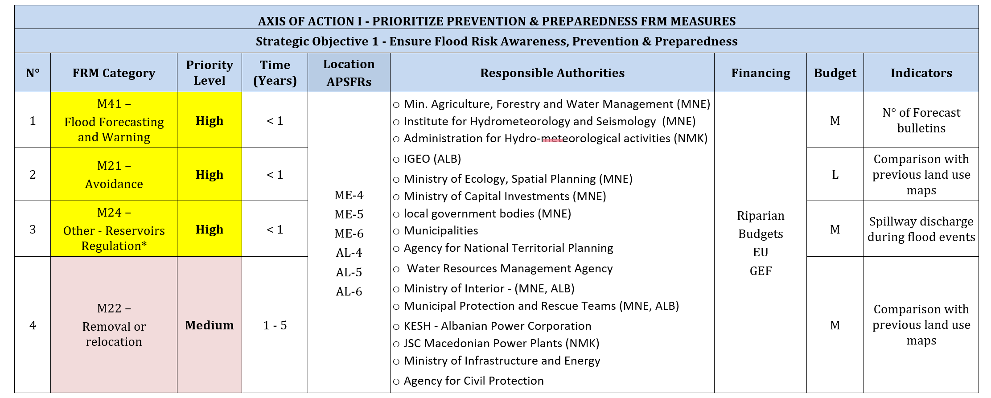
Example of FRM Action Plan by Macro-area
Lower Drin
AXIS OF ACTION I :

Slide 33
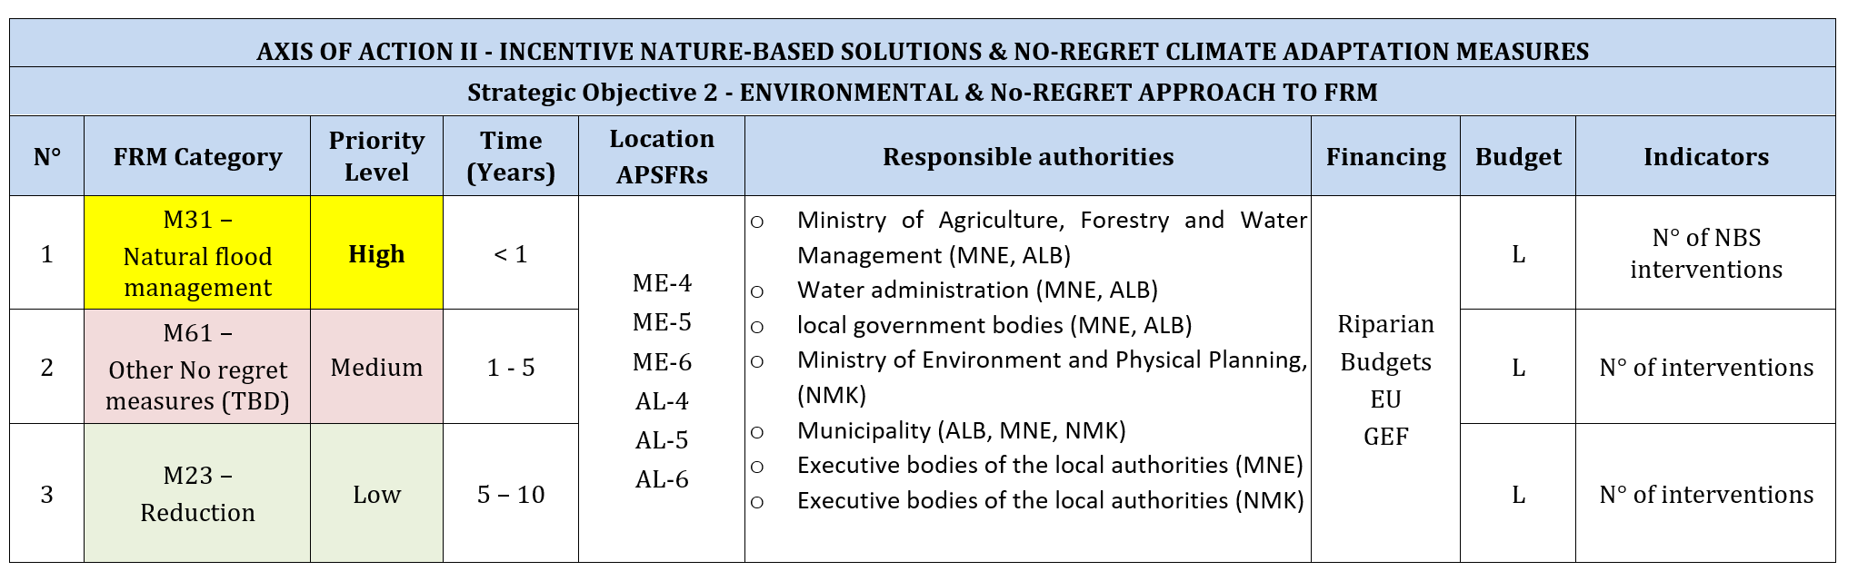
Example of FRM Action Plan by Macro-area
Lower Drin
AXIS OF ACTION II :

Slide 34
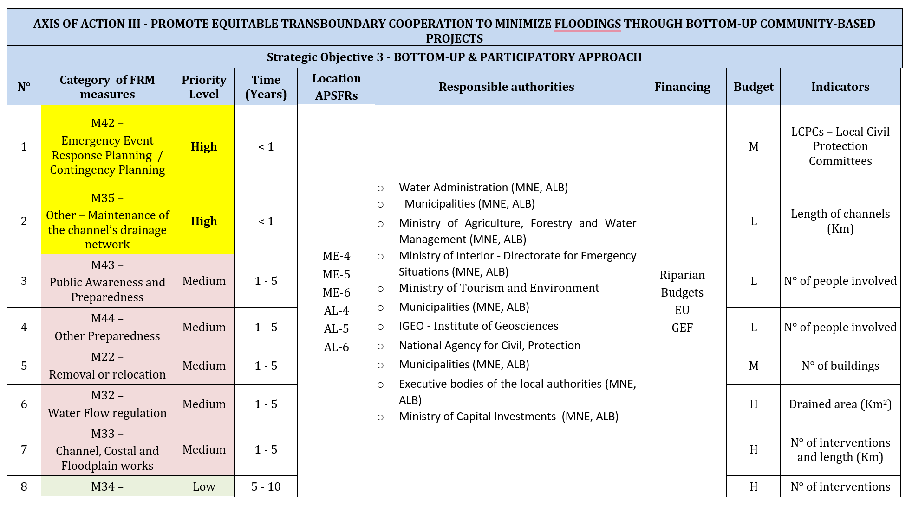
Example of FRM Action Plan by Macro-area
Lower Drin
AXIS OF ACTION III :

Slide 35
CONSULTATION PROCESS
Stakeholder Engagement for Validation of the FRM Strategy & FRM Action Plan
(After reviewing and acknowledgment from Drin CORDA - EWG)

Slide 36

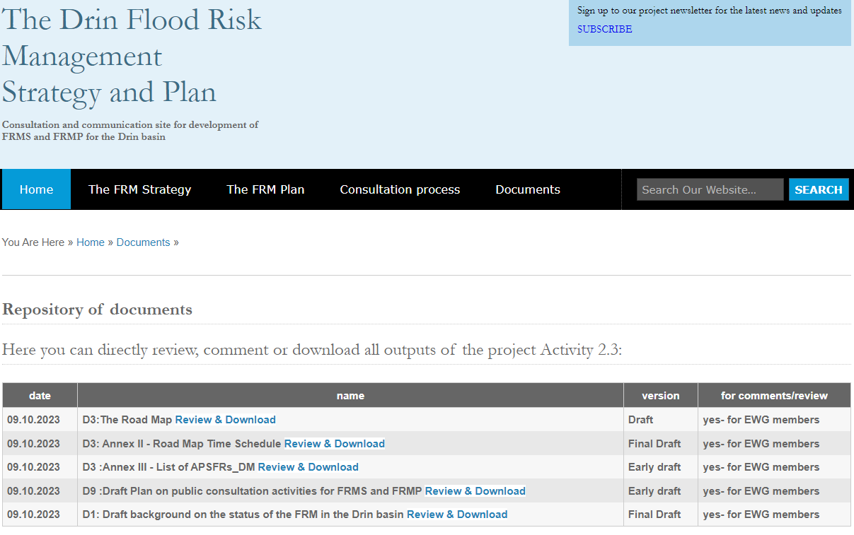
Communication Plan - floods.drinbasin.org

Slide 37
Transboundary FRM Action Plan Specific Actions
(Next Presentation)

Slide 38
THANKS FOR ATTENTION
Doubts, Clarifications ?

